Slide 1
D3 Workshop
Bon Adriel Aseniero, PhD
bon.aseniero@autodesk.com

Slide 2
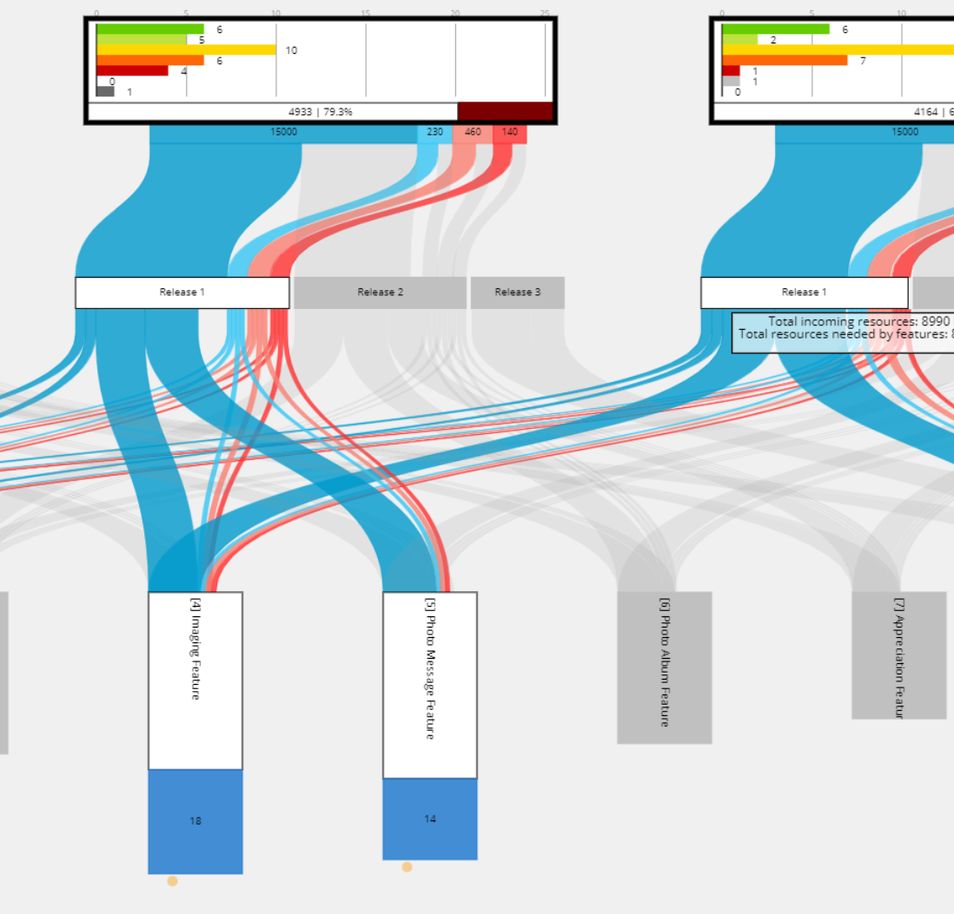
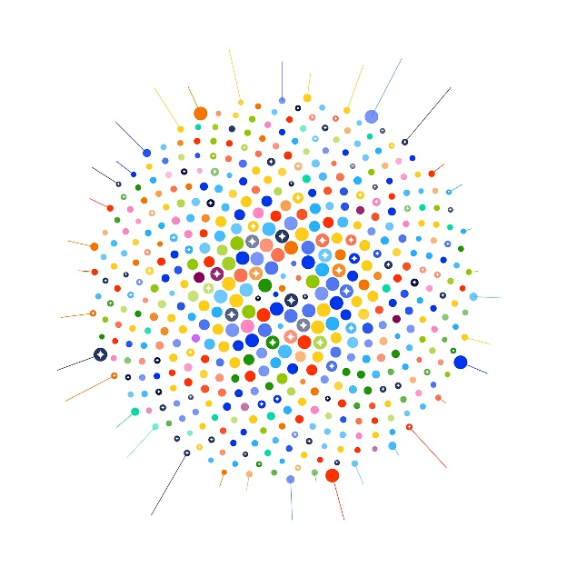
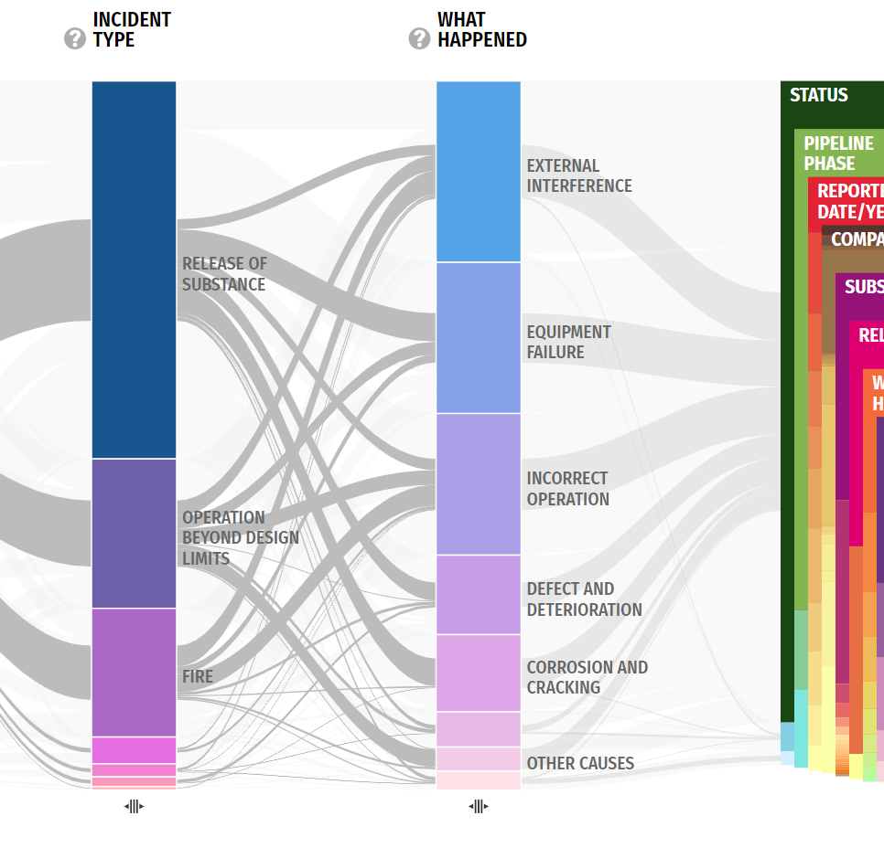
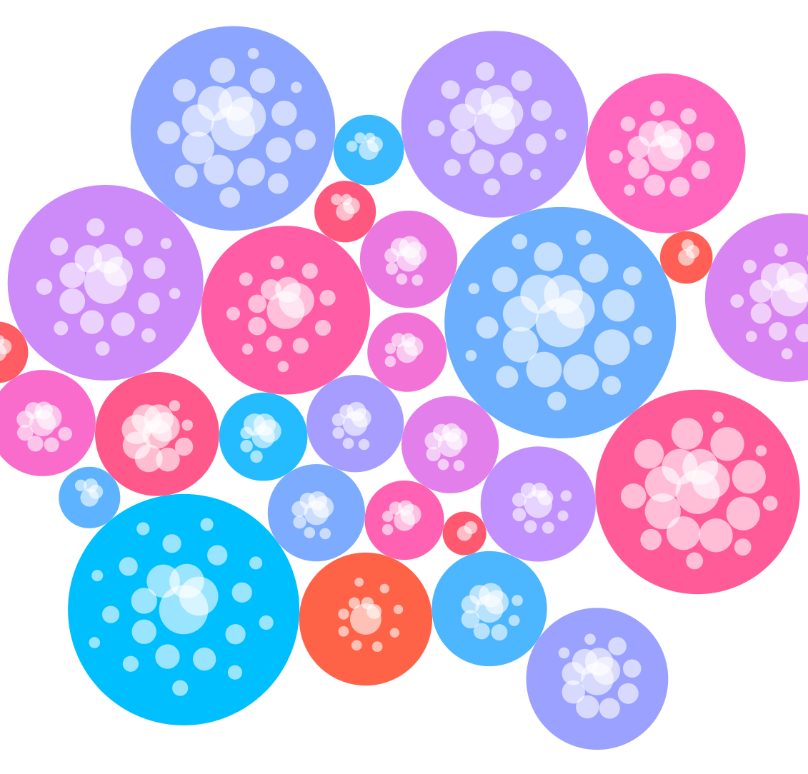
Bon Adriel Aseniero, PhD
Senior Research Scientist | Autodesk

Slide 3
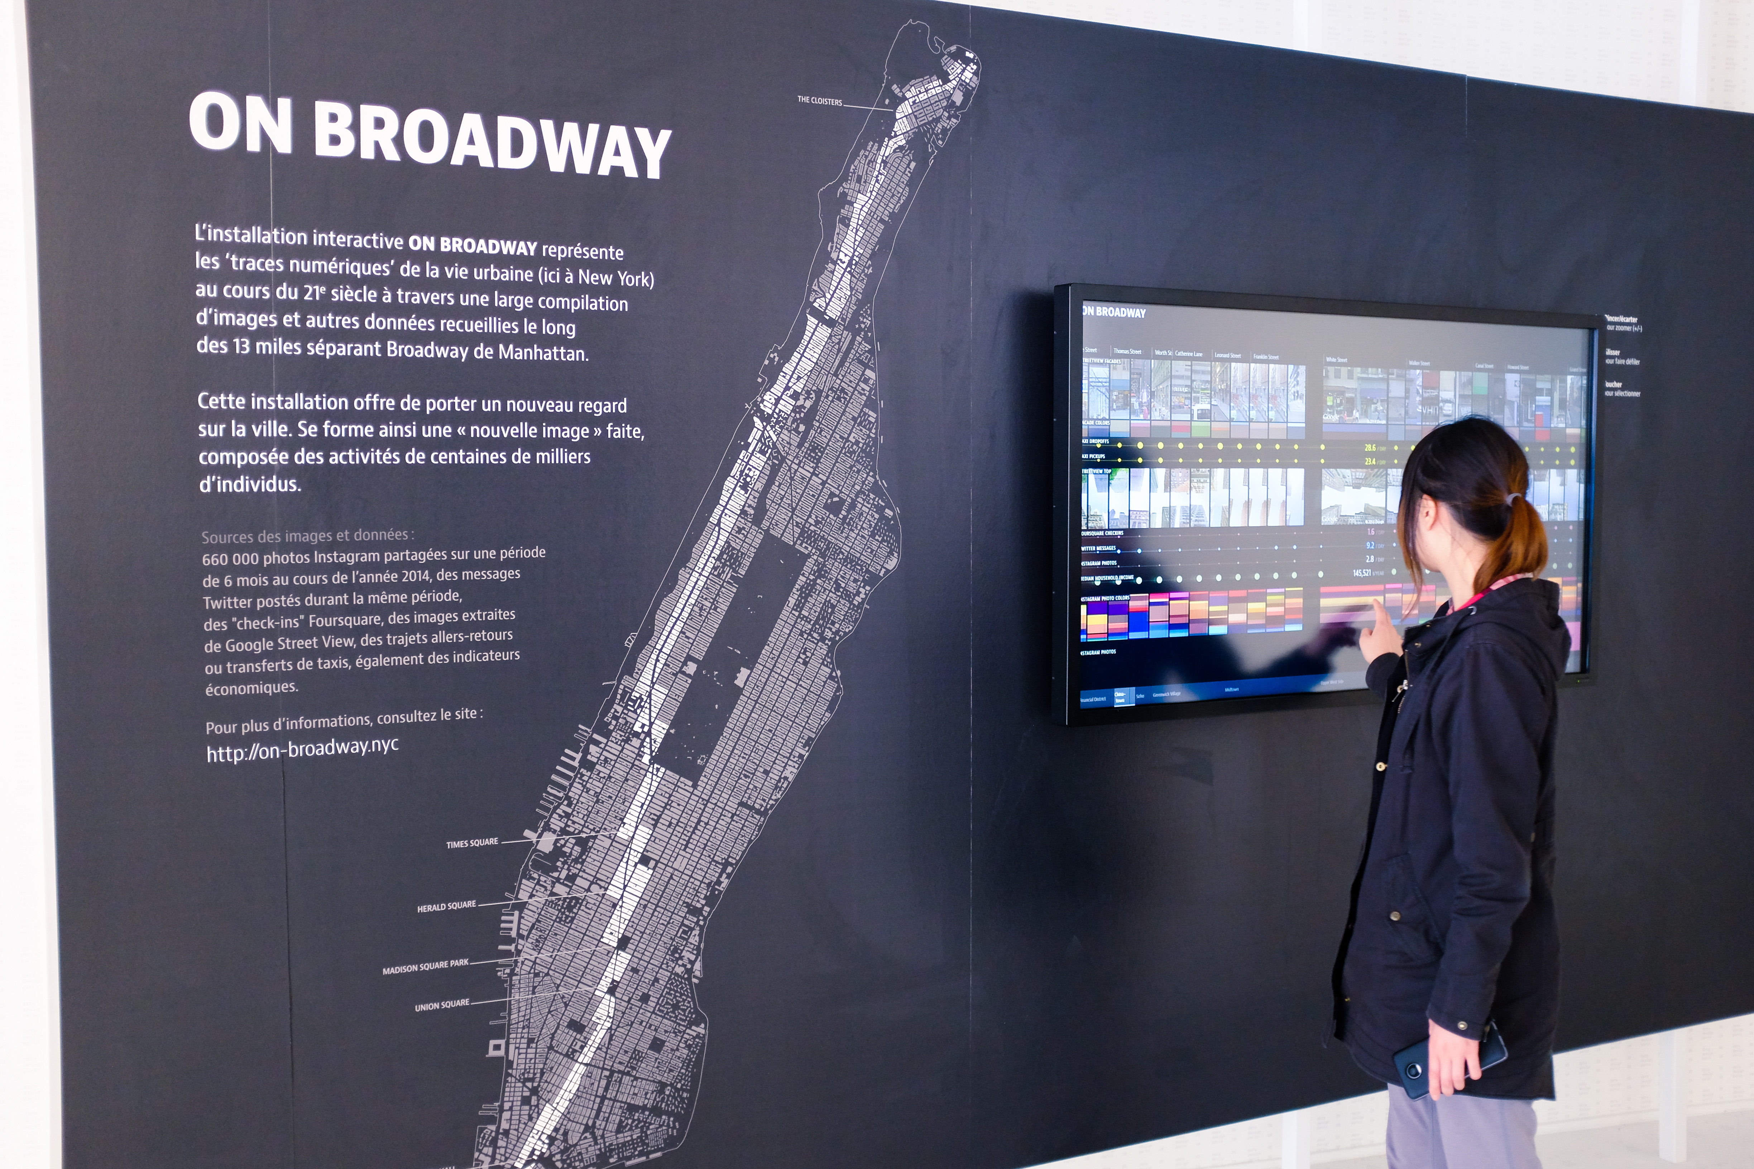
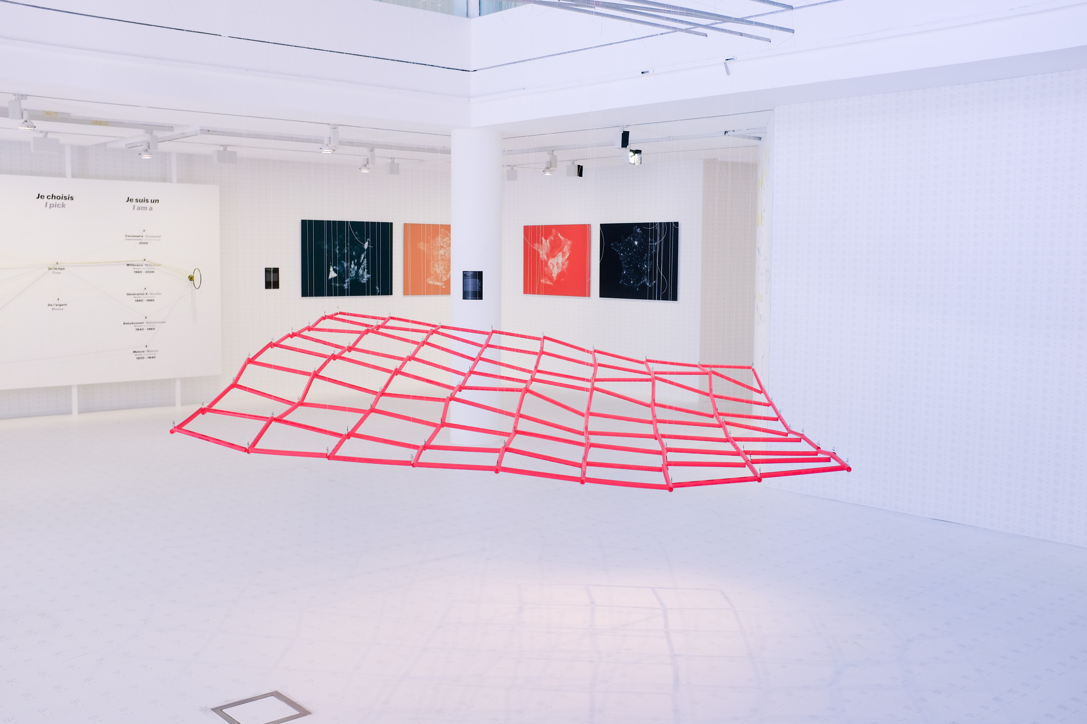

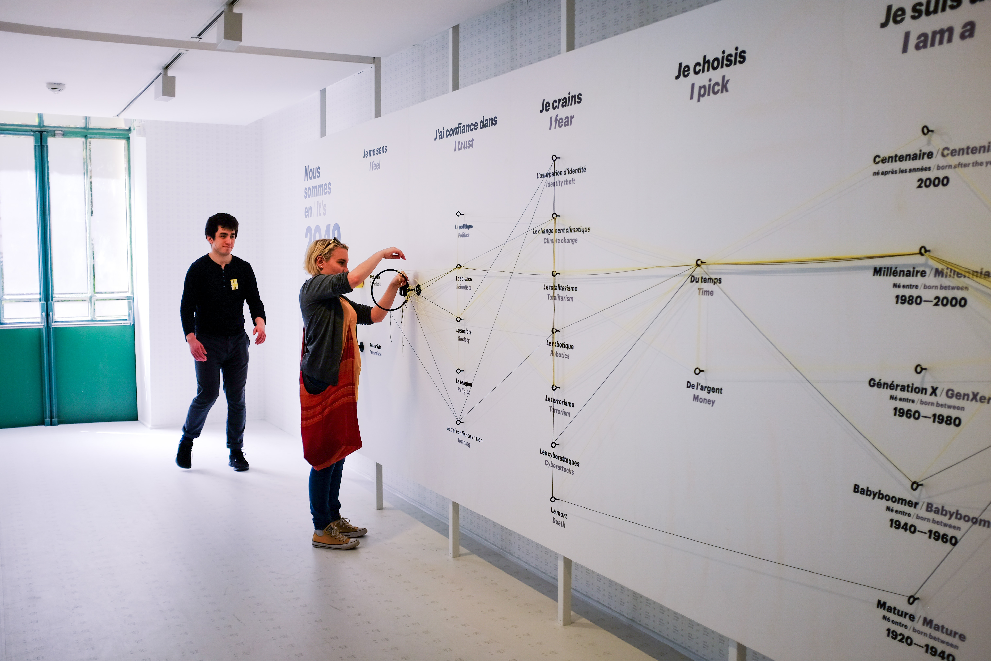
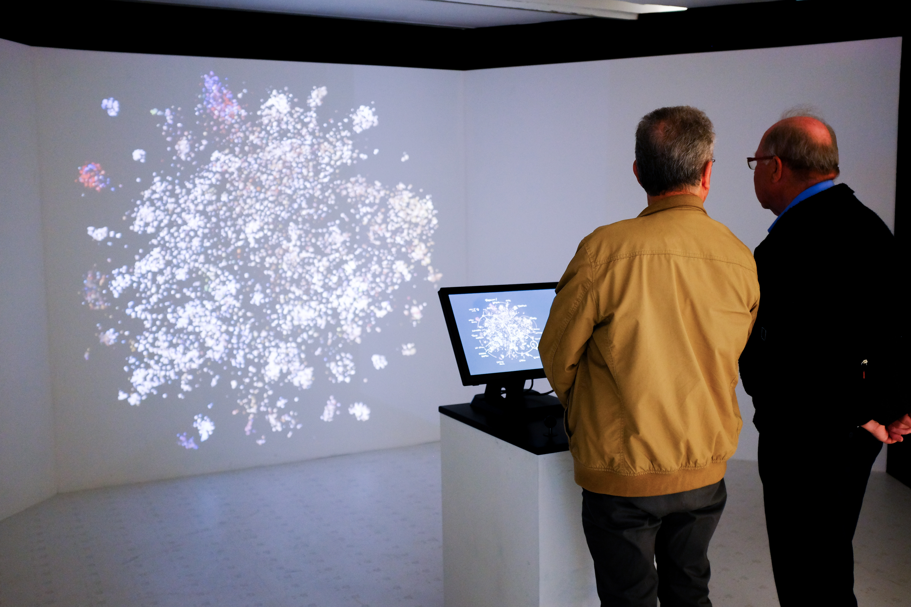
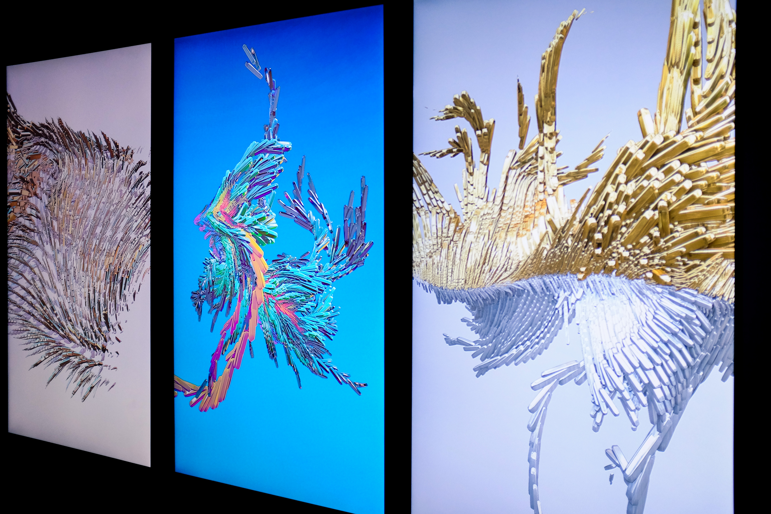
Images taken during the 123 Data Exhibition in Paris, France, May 2018. http://123data.paris/

Slide 4
Webstorm IDE
https://www.jetbrains.com/webstorm/

Slide 5
Materials
https://www.dropbox.com/sh/nb5wdpwtx3qk58f/AACxzU4wVprytXEjmibxz5yLa?dl=0

Slide 6
Notes:
What we will do

Slide 7
Workshop Agenda (3 hours)
Introduction to D3
Loading and Binding Data
Scales
Drawing Data
Making your own representations
Interaction
Simple interaction
Brushing and Linking
Notes:
breakdown

Slide 8
INTRODUCTION

Slide 9
HTML5/JavaScript

Slide 10
SVG: Scalable Vector Graphics
Vector-based graphics in XML format
Defined in the HTML DOM as SVG elements
<svg>...</svg>
Rectangles <rect> Attributes: x, y, width, height
Circles <circle> Attributes : cx, cy, r
Lines <line> Attributes : x1, y1, x2, y2
Polylines <polyline> Attributes : points - string list of x, y point pairs
e.g., “10,0 2,100, 45,38”

Slide 11
Hands-on: draw SVG objects

Slide 12
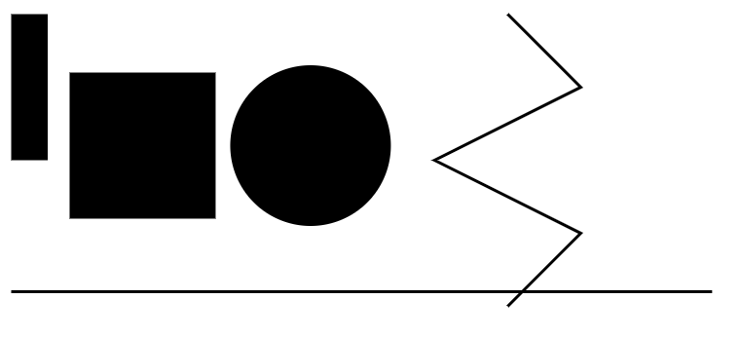

Slide 13
<svg class="small-vis" id="vis1"> <rect x="10" y="10" width="25" height="100"></rect> <rect x="50" y="50" width="100" height="100"></rect> <circle cx="215" cy="100" r="55"></circle> <line x1="10" y1="200" x2="490" y2="200" style="stroke:black; stroke-width:2"></line> <polyline points="350,10 400,60 300,110 400,160 350,210" style="fill:none; stroke:black; stroke-width:2"></polyline> </svg>
Notes:
Try adding an ellipse: <ellipse cx="200" cy="80" rx="100" ry="50"/>

Slide 14
SVG Reference:
https://www.w3schools.com/graphics/svg_intro.asp

Slide 15
D3

Slide 16
D3: Data-Driven Documents
“D3.js is a JavaScript library for manipulating documents based on data. D3 helps you bring data to life using HTML, SVG, and CSS. D3’s emphasis on web standards gives you the full capabilities of modern browsers without tying yourself to a proprietary framework, combining powerful visualization components and a data-driven approach to DOM manipulation.”
–d3js.org/
Notes:
D3 is declarative

Slide 17
D3: Data-Driven Documents
D3 is a “declarative” programming language
Describes what to do, not how to do something (imperative)

Slide 18
D3: Data-Driven Documents
D3 is a “declarative” programming language
Describes what to do, not how to do something (imperative)
Example: Changing the text colour of a paragraph
// Imperative (basic JavaScript)
var paragraphs = document.getElementsByTagName("p");
for (var i = 0; i < paragraphs.length; i++) {
var paragraph = paragraphs.item(i); paragraph.style.setProperty("color", "blue", null);
}

Slide 19
D3: Data-Driven Documents
D3 is a “declarative” programming language
Describes what to do, not how to do something (imperative)
Example: Changing the text colour of a paragraph
// Declarative (D3)
D3.selectAll("p").style("color", "blue");
Notes:
Supposedly this is better for non-coders… like designers

Slide 20
Loading Data from File
Use D3’s .csv function
/** * Load data from a CSV file as JSON objects * @param path the location of the CSV file to load */ function loadData(path){ d3.csv(path).then(function(data){ //do something with the data console.log(data); }); }

Slide 21
D3 Selection
Allows DOM elements to be selected so they can be manipulated declaratively.
.selectAll – selects all matching elements
e.g., d3.selectAll("rect") will find all rectangles in the DOM
.select – selects the first matching element
e.g., d3.select("#vis1") will select the first element in the DOM with an attribute id = "vis1“
Resource: https://www.d3indepth.com/selections/

Slide 22
D3 Selection
D3 selections are “virtual” as the elements do not have to exist, yet, in the DOM in order for them to be selected.

Slide 23
UPDATE:
DOM elements that have new data bound to them. As of D3 v5, this is handled by “join”
ENTER:
Data which are not yet bound to any DOM elements
EXIT:
DOM elements that no longer have any data bound to them

Slide 24
function drawCountries(data){ let svg = d3.select("#vis2");
// for dynamic sizing svg.attr("viewBox", `0, 0, ${$("#vis2").width()}, ${$("#vis2").height()}`); svg.selectAll("rect") .data(data) .enter() .append("rect") .attr("x", function(d,i){ return (i+1) * 15; }) .attr("y", 10) .attr("width", 10) .attr("height", 200); }
Notes:
Here, there are no rectangles yet, until we use APPEND

Slide 25

Notes:
Each country in our dataset is represented as a bar

Slide 26
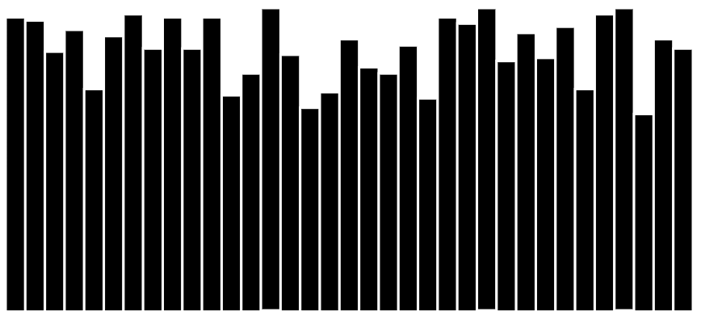
Notes:
Let’s use a data property like ‘water quality’ to change the height of the bars

Slide 27
function drawBars(data){ let svg = d3.select("#vis3");
// for dynamic sizing svg.attr("viewBox", `0, 0, ${$("#vis3").width()}, ${$("#vis3").height()}`); // setup margins and dimensions let width = $("#vis3").width(), height = $("#vis3").height(); let barWidth = width / data.length;
...

Slide 28
D3 Scales
Scale functions that map from an input domain to an output range.
Hence, they are typically used to transform (map) data values into visual variables (e.g., position and colour).

Slide 29
D3 Scale Types
Quantitative Scales
Have continuous domain (e.g., set of real numbers)
D3 examples: Linear Scale, Power Scale
Ordinal Scales
Have a discrete domain (e.g., categories, set of names)
D3 example: Categorical Colours
Time Scales
A type of quantitative scale specific to measures of time (e.g., dates)

Slide 30
// setup D3 scales // Here we create linear scales to map our x values // to the width of the svg viewport let xScale = d3.scaleLinear() .domain([0, data.length]) .range([0, width]); // limit our range within the margins // Here we create linear scales to map our y values // to the height of the svg viewport let yScale = d3.scaleLinear() .domain([0, d3.max(data, function(d) { return d['Water quality']; })]) .range([height, 0]);

Slide 31
svg.selectAll("rect") .data(data) .enter() .append("rect") .attr("x", function(d,i){ return xScale(i); }) .attr("y", function(d){ return yScale(d['Water quality']); }) .attr("width", barWidth) .attr("height", height)
// add in-line styles .style("stroke", "white") .style("stroke-width", 2);

Slide 32
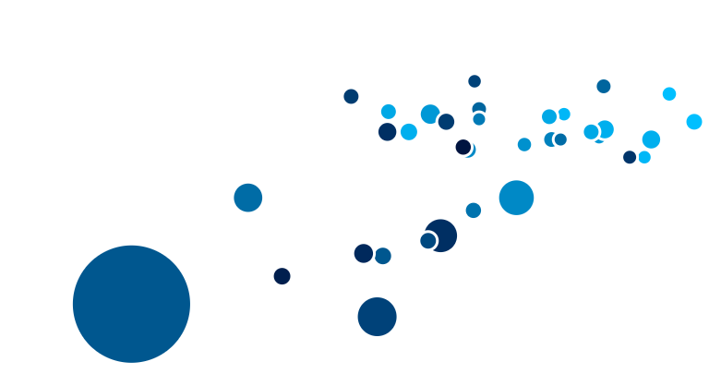

Slide 33
function drawCircles(data){ let svg = d3.select("#vis4"); // for dynamic sizing svg.attr("viewBox", `0, 0, ${$("#vis4").width()}, ${$("#vis4").height()}`); // setup margins and dimensions let width = $("#vis4").width(), height = $("#vis4").height(); let maxDiameter = 40; // setup D3 scales // Here we create linear scales to map our x values // to the width of the svg viewport let xScale = d3.scaleLinear() .domain([30, d3.max(data, function(d) { return d['Feeling safe walking alone at night']; })]) // limit our range within the margins .range([maxDiameter, width-maxDiameter]); // Here we create linear scales to map our y values // to the height of the svg viewport let yScale = d3.scaleLinear() .domain([d3.min(data, function(d) { return d['Life expectancy']; }), d3.max(data, function(d) { return d['Life expectancy']; })]) .range([height-maxDiameter, maxDiameter]);

Slide 34
let rScale = d3.scaleLinear() .domain([0, d3.max(data, function(d) { return d['Homicide rate']; })]) .range([5, 15]); let colorScale = d3.scaleLinear() .interpolate(d3.interpolateHcl) .domain([d3.min(data, function(d) { return d['Life satisfaction']; }), d3.max(data, function(d) { return d['Life satisfaction']; })]) .range(['rgb(0,0,0)', 'rgb(0,191,255)']) .clamp(true);

Slide 35
svg.selectAll("circle") .data(data) .enter() .append("circle") .attr("cx", function(d){ return xScale(d['Feeling safe walking alone at night']); }) .attr("cy", function(d){ return yScale(d['Life expectancy']); }) .attr("r", function(d){ return rScale(d['Homicide rate']); }) .style("fill", function(d){ return colorScale(d['Life satisfaction']); }) .style("stroke", "white") .style("stroke-width", 2);

Slide 36
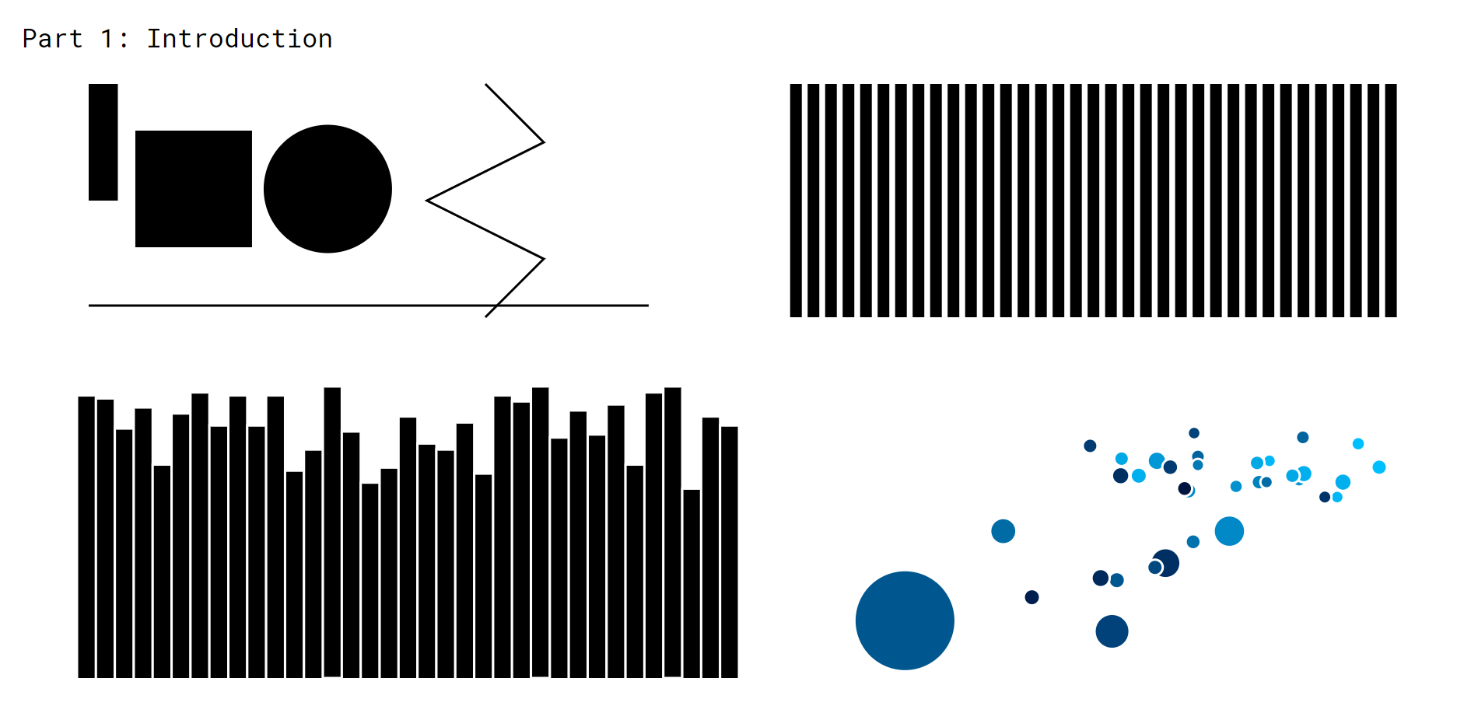

Slide 37
DRAWING DATA

Slide 38
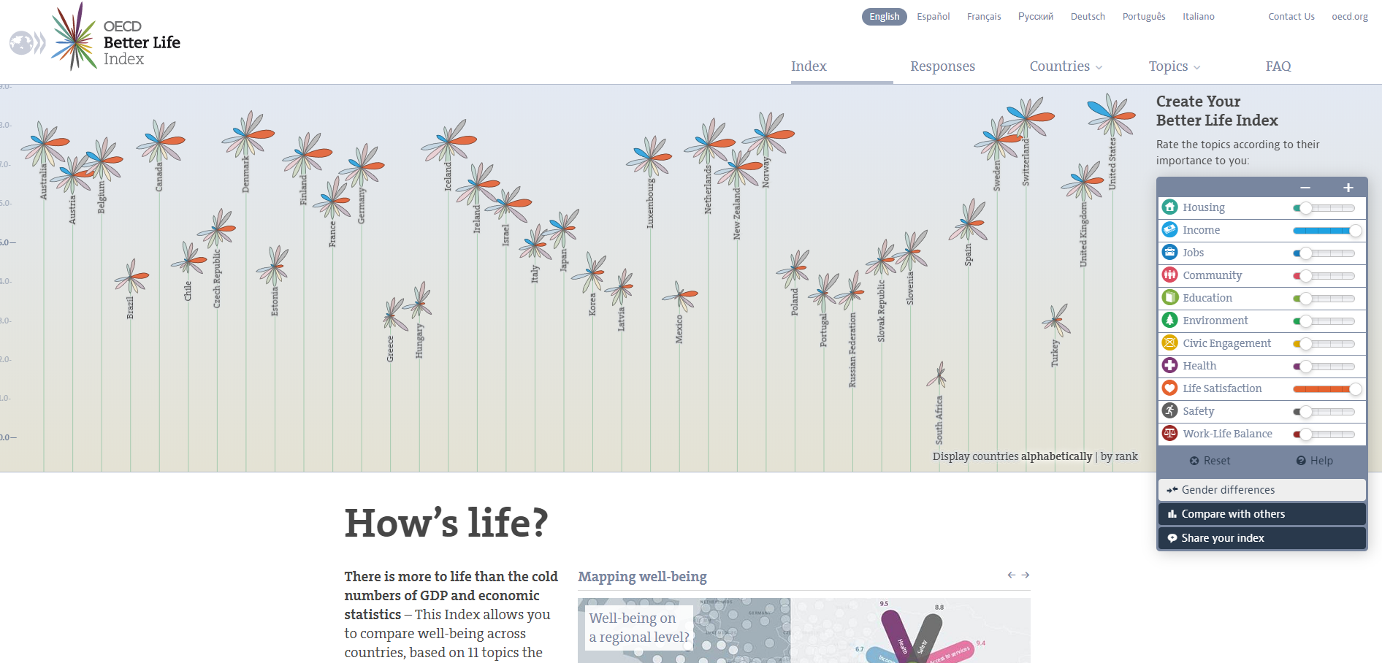

Slide 39
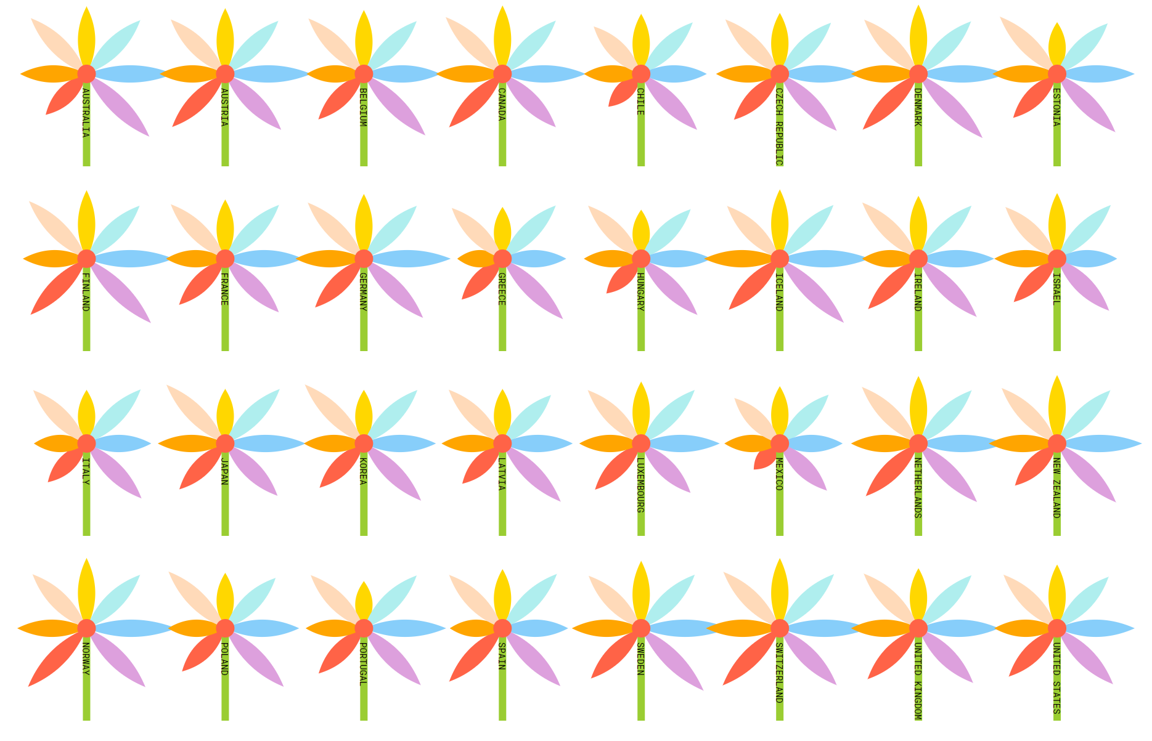

Slide 40
Combining SVG paths to make something new

Slide 41
Think about the component shapes of your metaphor

Slide 42

Components of a flower
Petals – Curved Paths
Flower head – a Circle
Stem – a Line
These will all be contained in a group element “g”

Slide 43
SVG Groups “g”
As we have seen before, you can use this element (denoted as <g></g> tags in the HTML document) to group other SVG elements together.
You can apply transformations into the group which will apply to all the elements in it.
Note: You cannot style groups.

Slide 44
Process
First, create a group that will contain all our svg elements
this.flowers = this.svgContainer.selectAll("g") .data(this.data) .enter() .append("g") .attr("class", "flower_group") .attr("width", this.FLOWER_WIDTH) .attr("height", this.FLOWER_HEIGHT) ...

Slide 45
.attr("transform", function(d, i){ let new_i = i + 1; let x_padding = new_i % max_num_of_items === 0 ?
max_num_of_items : new_i % max_num_of_items, y_padding = i >= max_num_of_items ?
1 + Math.floor(i/max_num_of_items) : 1; let x_translate = d3.select(this).attr("width") * (x_padding - 1), y_translate = d3.select(this).attr("height") * (y_padding - 1); return `translate(${x_translate}, ${y_translate})`; });

Slide 46
Process
Draw a petal (using svg:path definition of a quadratic Bezier curve) and add it to our flower_group.
second point (top)
MX Y Q CX CY, DX DY …
M origin.x origin.y
Q ctrl1.x ctrl1.y,
top.x top.y
Q ctrl2.x ctrl2.y,
origin.x origin.y
Z
First ctrl point (ctrl1)
second ctrl point (ctrl2)
First point (origin)

Slide 47
...
// Add a path into the group using a Quadratic Bezier curve definition // recall the quadratic curve definition: Mx y, Q cx cy, dx dy // where x and y are the coords of the point of origin, cx and cy is the control point, // and dx dy is the next point (this can be followed up by another control point and next point ... let petal = petal_group.append("path") .attr("class", "flower_petal") .attr("selector", selector) .attr("d", function(d){ let origin = {x : _this.FLOWER_WIDTH/2, y : _this.FLOWER_HEIGHT/2}; let scale = d3.scaleLinear() .domain([0, max_val]) .range([0, _this.FLOWER_HEIGHT/2]); let top = {x : origin.x, y : origin.y - scale(d[selector])}; let ctrl1 = {x : origin.x - (origin.x/4), y: top.y + ((_this.FLOWER_HEIGHT/2-top.y)/2)}; let ctrl2 = {x : origin.x + (origin.x/4), y: top.y + ((_this.FLOWER_HEIGHT/2-top.y)/2)}; let path = `M${origin.x} ${origin.y} Q ${ctrl1.x} ${ctrl1.y}, ${top.x} ${top.y} Q ${ctrl2.x} ${ctrl2.y}, ${origin.x} ${origin.y} Z`; return path; }) .style("opacity", 0) .style("fill", fill);
...

Slide 48
Encapsulate the path into another group which we can rotate, add width and height to, etc.
// create a group that will contain the SVG:path for our petal let petal_group = this.flowers.append("g") .attr("transform", `rotate(${rotation_angle}, ${_this.FLOWER_WIDTH/2}, ${_this.FLOWER_HEIGHT/2})`);

Slide 49
Repeat this step to create the other petals. Use a reusable function.
// Add the petals to our flower this.addPetal(0, "Life satisfaction", 10, "gold", "orange"); this.addPetal(45, "Life expectancy", 100, "paleturquoise", "mediumturquoise"); this.addPetal(90, "Water quality", 100, "lightskyblue", "deepskyblue"); this.addPetal(135, "Years in education", 20, "plum", "orchid"); this.addPetal(225, "Feeling safe walking alone at night", 100, "tomato", "firebrick"); this.addPetal(270, "Employment rate", 100, "orange", "darkorange"); this.addPetal(315, "Student skills", 600, "peachpuff", "lightsalmon"); ...
/** * Function that adds a petal to a flower group. The petal's length is based off a data, * accessed through a given property selector * @param rotation_angle (number, degree) the angle of rotation for the petal * @param selector (string) the property of the data which will determine * @param max_val (number) the maximum value the data domain has (used for scaling values to screen pixels) * @param fill (colour string) the colour of the petal * @param stroke (colour string) the colour of the stroke outlining the petal on hover */ this.addPetal = function(rotation_angle, selector, max_val, fill, stroke){ ...

Slide 50
Add the stem and the flower head.
// Add our stem this.flowers.append("line") .attr("x1", _this.FLOWER_WIDTH/2) .attr("y1", _this.FLOWER_HEIGHT/2) .attr("x2", _this.FLOWER_WIDTH/2) .attr("y2", _this.FLOWER_HEIGHT) .style("stroke-width", 5) .style("stroke", "yellowgreen") .style("opacity", 0) .transition() .style("opacity", 1); // Add our flower head let flower_head = this.flowers.append("circle") .style("fill", "tomato") .attr("cx", this.FLOWER_WIDTH/2) .attr("cy", this.FLOWER_HEIGHT/2)

Slide 51
INTERACTION

Slide 52
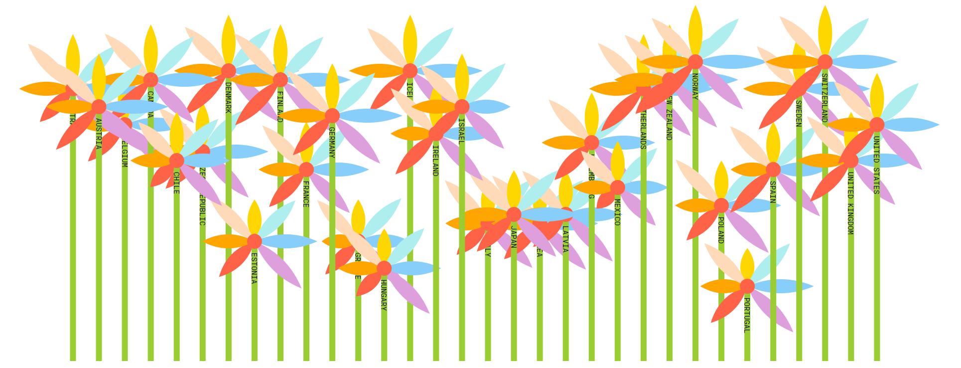

Slide 53
Events
Use the .on method to attach event listeners to your elements.
You can use predefined event names such as:
mouseover, mouseout, click, etc.
Syntax:
.on(<event_name>, <callback_function>)

Slide 54
Note: any listeners (.on(“eventname”, callback)) should appear separately or you could encounter errors. e.g.:
petal .transition() .style("opacity", 1) .duration(800); petal .on("mouseover", function(d){ d3.select(this) .style("stroke-width", 5) .style("stroke", stroke); d3.selectAll(".flower_petal") .filter(function(e){ return d3.select(this).attr("selector") !== selector; }) .transition() .style("opacity", 0.1); })
Notes:
Where petal is the variable name I’m using for the group element containing the svg:path for a petal

Slide 55
Adding Animations
Use the transition() method.
Any attribute that appears after this line of code will be animated every time it changes.
petal .transition() .style("opacity", 1) .duration(800);
Notes:
Use it on opacity, positioning, etc.

Slide 56
That’s it!
Thanks :)

